Slide 1
Math Co-Processor 8087
Why 8087 is used with 8086/ why 8087 interfaced with 8086??????
It is numerical data processor which means processor is design to perform complex arithmetic operations.
8086 is also worked on arithmetic operation but they are very simple.
8087 is worked on Real Complex Arithmetic operations like :
Addition, Subtraction, Division, Multiplication
Square root, Trigonometry, Laws, X^{y}
2. 8087 works on very big number i.e. 80 bit number.
8087 has very powerful instruction set. It has direct instruction to do practically everything that you see in
scientific calculator. Instruction available for every button of scientific calculator.
4. 8087 has capability to work with floating point numbers. i.e. fraction. Example : square root of (5.7)

Slide 2
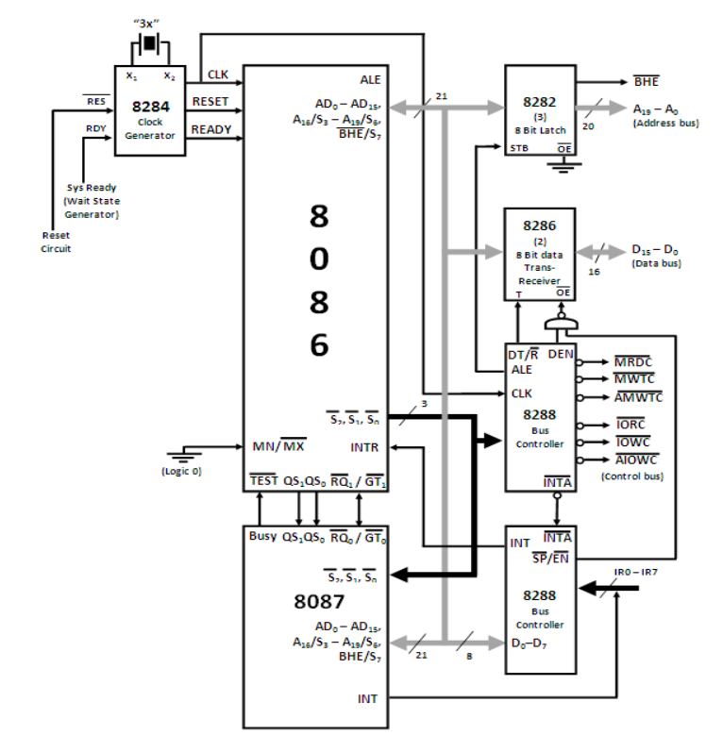


Co-Processor Configuration 8086 - 8087
In the diagram following blocks are there:
8284 Clock generator which is used to provide clock related signals to 8086 and other connected devices.
8282 latch which is used separate the address bus.
8286 transceiver which is used to separate the data bus.
8288 bus controller which is used to handle the control bus.
8087 math co-processor to perform complex arithmetic operations.
8259 programmable interrupt controller to handle the interrupt request.
8259 is used to increase the number of interrupts.
8259 device is used to handle the interrupt requests and send it to the processor.
Any device which wants to interrupt the processor can not directly interrupt the processor it will send interrupt request to 8259.
8259 will send that interrupt request through INTR pin which is non-vectored(Processor don’t know the address of an ISR).
8086 sends the status signal to 8288 to generate INTA bar s/g
8288 will generate the INTA bar signal to ask vector number. 8259 calculates the vector address.
Again 8086 generate second time INTA bar signal through 8288.
After receiving second time INTA bar 8259 will provide vector number of an ISR to 8086 and 8086 executes that interrupt.

Slide 3
Who wants to interrupt the 8086 processor?
When 8087 wants to interrupt the processor?
8087 wants to become bus master
8087
When any device wants service or if there is problem it will send interrupt request
If 8087 wants to become bus master it will send bus request
There is a difference between bus request and interrupt request
8087 dose the floating point operations.
During those operations there 6 types of errors or exceptions can occurs :
Precision, divide zero, overflow, underflow, invalid operation, denormal
If there is any type of error occurred 8087 interrupt the processor
But it can not directly interrupt to processor.
It will interrupt through 8259.

Slide 4
8087 is also a processor, it can also become a bus master to perform operations.
To perform operations it also required clock pulses.
When you reset computer both processor should reset.
When co-processor dealing with other devices ready s/g is used.
Hence all clock signals are applied to 8087 also
8086 or 8087 who ever is a bus master will generate multiplexed bus and 8282 and 8286 is responsible to separate the address and data bus.
8087 interrupt to 8086 through 8259. 8259 sends an interrupt request to 8086 and receive 2 – INTA bar signals through 8288.
On second INTA bar signal 8086 send vector number to 8086 through data bus.
There is a chance that vector number is mixed up with data which is transmit or receive by 8286. because vector no. can also received by 8286.
Hence it is responsibility of 8259 to disable the 8286 by using SP bar/EN bar pin
SP
/ EN
Cascaded mode
Single mode

Slide 5
RQ -
GT
If 8087 wants to become bus master it will send request to 8086 using RQ bar.
After receiving RQ bar signal 8086 releases the system bus and grant the permission by sending GT bar signal.
Now 8087 is bus master, it will perform its task and after finishing its work it will send release signal to 8086.

Slide 6
Memory
8086 and 8087 both processors can executes the programs.
8086 is a Master (M) and 8087 is a slave (S) Processor. Which means every activity performed by 8087 is controlled or given by 8086.
When 8086 wants to give new operation to 8087, first 8086 has to know whether 8087 is busy or free.
Busy means to perform its own operations (complex ). If 8087 is busy then it will send 1 on BUSY line which is connected with TEST bar pin of 8086.
So whenever 8086 wants to give new task to 8087 it will check the status of TEST bar pin.
If test bar not checked by processor it will send new task and 8087 will leave the current task and star with new task.
Which means 8086 has to check TEST bar and if it is 1 the 8086 will enters into WAIT state.
If TEST bar =0, 8087 not busy & if TEST bar=1, 8087 busy ,8086 in wait state.
Which means at time only one processor is working.
Address Bus
8086
M
Data Bus
TEST
S2
S1
S0
QS 0
QS 1
Combine Program
8087
BUSY
Multiprocessing
Both processors works together.
Can not achieve multiprocessing
S
If 8086 checks the TEST bar and TEST bar is 1 then only 8086 has to enter into wait state.
8086 never check TEST bar pin
All the time
When 8086 checks the TEST bar??
As a programmer we force 8086 to check TEST bar pin.
When should we make the 8086 to checks the TEST bar??

Slide 7
Memory
For both i.e. 8086 and 8087 having combine program into memory (mixed program)
Address Bus
8086
Every instruction is fetched by 8086.
Data Bus
8087 never fetch the instruction. It can perform memory read or write as a bus master but can’t fetch the instruction.
M
But every fetched instruction by 8086 is also received by 8087.
8087
Program
8086
Program
TEST
Who fetches the instructions ??
S2
S1
S0
Only 8086
QS 0
QS 1
Who will get the instructions??
Both 8086 and 8087
There is first instruction which is 8086 processor’s instruction fetch by 8086.
8087
Both processors will get that instruction.
Fetched instruction is goes into the instruction queue of both processors.
BUSY
How to identify whether it is an 8086 instruction or 8087 ?
Both will decode the instruction.
S
Every instruction of 8087 began with binary pattern i.e.(11011) ESC – instruction prefix
8086 fetch the instruction, both will receive and decode the instruction and search for ESC, if ESC found an instruction is executed by 8087 and 8086 will discard the instruction from queue and vice-versa

Slide 8
Memory
As a programmer we force 8086 to check TEST bar pin.
Address Bus
8086
When should we make the 8086 to checks the TEST bar??
All these are the 8086 instructions so no need to check test bar pin.
M
Data Bus
As a programmer we know that this one is the 8087 instruction.
WAIT
1
W
0
If this instruction fetch by 8086 it will receive and decode by both and 8087 executes this instruction and leaves the previous instruction.
TEST
S2
S1
S0
QS 0
QS 1
Hence before fetching this instruction 8086 has to check whether 8087 is free or not
As a programmer are going to write WAIT instruction before 8087 instruction.
8087
By executing wait instruction 8086 will check the TEST bar pin
BUSY
If TEST bar = 1 , 8086 will wait until 8087 got free.
1
Once 8087 completes its own task it will send 0 on Busy pin
S
By receiving 0 on TEST bar, 8086 exits from wait state and fetch the next instruction.

Slide 9
Memory
Address Bus
Every instruction is fetched by 8086 and also received by 8087
8086
It is not necessary that every data which is required to 8086 is also required to 8087
M
Data Bus
Bus carries both address and data
100
8288
WAIT
1
W
0
8087 must know whether the bus carries data or bus
TEST
S2
S1
S0
When 8086 fetch the instruction it will send status signal 100 to 8288, which informs about the instruction fetch operation.
QS 0
QS 1
8288 will also send this status to 8087
QS0 – QS1
They are used to synchronised activity on both queue
8087
BUSY
QS1 | QS0
0 | 0 | NOP
0 | 1 | Remove Opcode
1 | 0 | Clear Queue
1 | 1 | Remove operand
1
S
100
S2
S1
S0

